Slide 1
MEC101
Mechanical Sciences-I

Slide 2
The Course
Statics
Stress & Strain
Stress Transformations
Torsion
Bending
Introduction to Graphics

Slide 3
The Grade
MTE: 20
ETE: 40
CA: 40 Attendance: 10%
Assignments:72%
Term Paper: 18%

Slide 4
Structures
This course is concerned with structures.
A structure is a solid object or assembly. A structure connects components, carries loads, provides form and integrity.

Slide 5
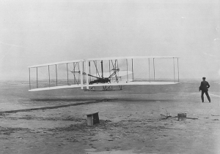
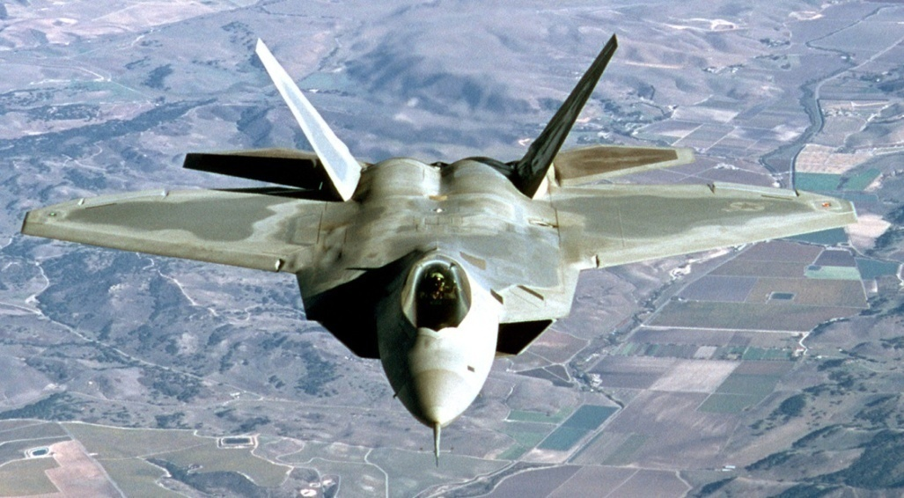
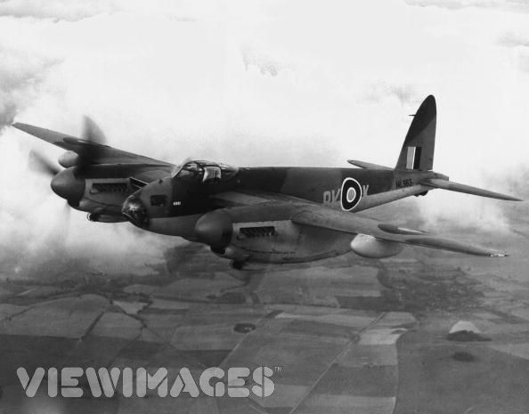
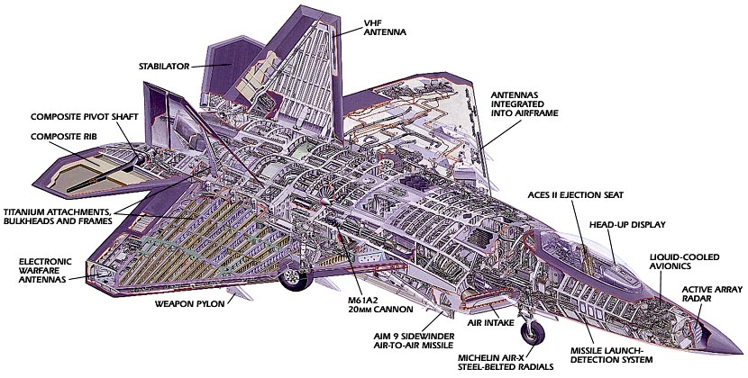
Structures
Wright Flyer, 1903
F22, 2002
Mosquito 1943

Slide 6
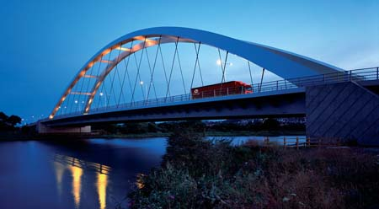
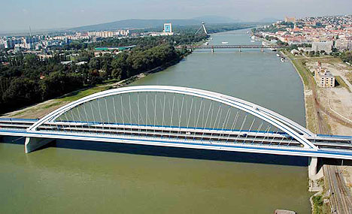

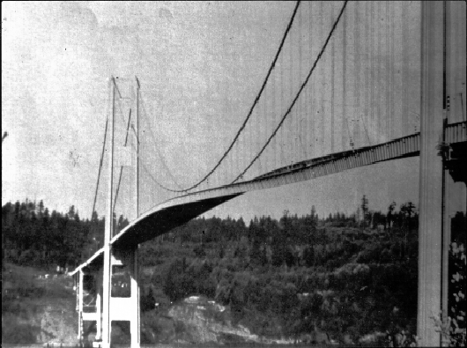
Bridges

Slide 7
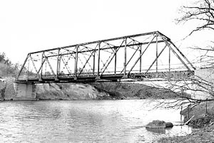
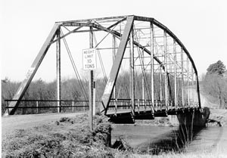
Trusses

Slide 8
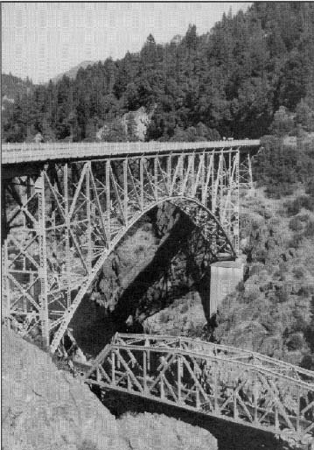
Trusses

Slide 9

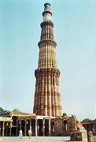
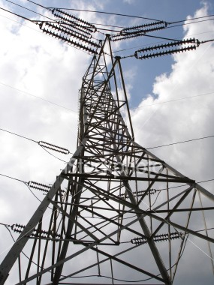
Tall Structures

Slide 10
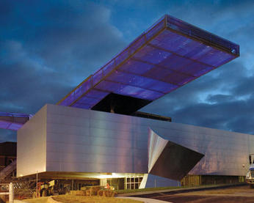

Roofs

Slide 11
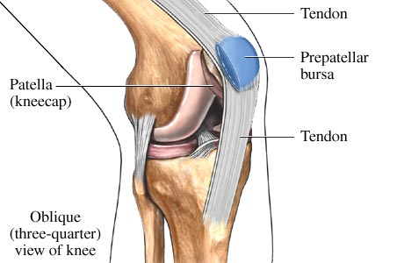
Legs

Slide 12
How to solve problems:
1. SI units only.
2. Good sketches.
• Labelled coordinate system.
• Labelled dimensions and forces.
3. Show your thought process.
4. Follow all conventions.

Slide 13
How to solve problems...
5. Solve everything symbolically until the end.
6. Check answer ⇒ Does it make sense?
• Check trends.
• Check units.
7. Plug in to get answers.

Slide 14
Concept of Force

Slide 15
Concept of Force
Newton’s First Law:
A body continues in a state of rest or uniform motion in a straight path unless a force is used to disturb it.

Slide 16
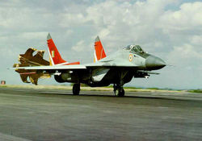
Concept of force
An apple drops to earth from a tree.
The braking parachutes of MIG-29

Slide 17
Concept of Force
Changing direction

Slide 18
Concept of Force
Object in a circular path
•
•

Slide 19
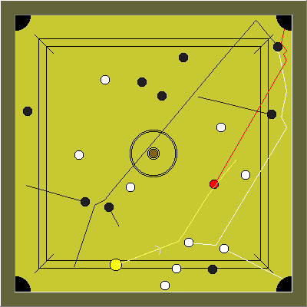
Concept of Force

Slide 20
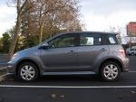
Concept of Force

Slide 21

Concept of Force

Slide 22
Concept of Force
Third Law:
For every action, there is an equal and opposite reaction.

Slide 23
Concept of Force
Consequence of the Third Law:
Forces always exist in pairs, with two bodies involved in it.

Slide 24
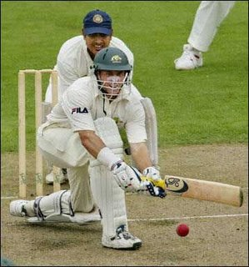

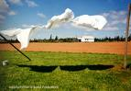
Concept of Force
Contact forces

Slide 25
Concept of Force
Forces at a distance
Gravitational forces
Electrostatic forces
Magnetic forces

Slide 26
Concept of a Rigid Body
Most bodies deform.
Bar
A rigid body does not deform

Slide 27
Concept of a Rigid Body
Distance between any two points does not change when a force is applied on it.
●
●

Slide 28
Newton’s Second Law
Force ~ mass×acceleration
Force = mass×acceleration

Slide 29
Unit Systems
FLT system:
Force = mass×acceleration
Pound Force
Ft/sec²
Slug

Slide 30
Unit Systems
MLT system:
Force = mass×acceleration
kg
N
m/s²

Slide 31
How to solve problems:
1. SI units only.
2. Good sketches.
• Labelled coordinate system.
• Labelled dimensions and forces.
3. Show your thought process.
4. Follow all conventions.

Slide 32
How to solve problems...
5. Solve everything symbolically until the end.
6. Check answer ⇒ Does it make sense?
• Check trends.
• Check units.
7. Plug in to get answers.

Slide 33
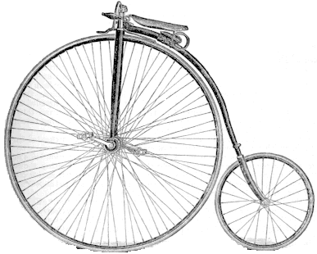
Transmissibility of Forces
●
●
●
●

Slide 34
Resultant of Forces
Law of Parallelogram of forces:

Slide 35
Resultant of Forces
Triangle of forces of forces:

Slide 36
Resolving a force

Slide 37
Force as a Vector
F = F_{x} i + F_{y} j
F_{y}
F
F = F_{x} i + F_{y} j + F_{z} k
F_{x}
y
F_{x}
F_{y}
F_{z}
x
F =
z

Slide 38
Addition of Forces
F₁ = F_{x1} i + F_{y1} j
F₂ = F_{x2} i + F_{y2} j
R = F₁ + F₂ = (F_{1x} + F_{2x})i + (F_{1y} + F_{2y}) j

Slide 39
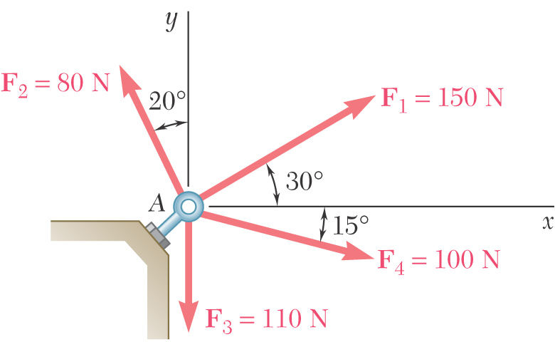
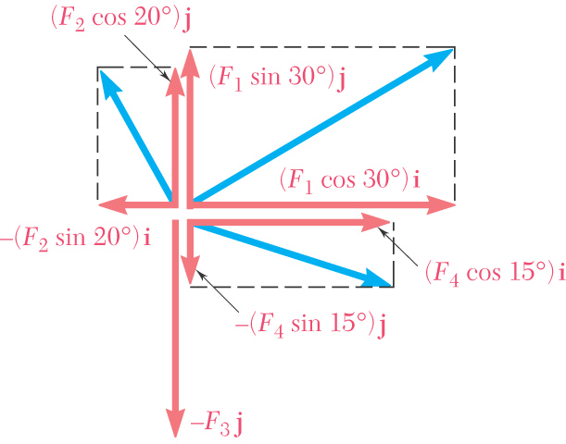
Example

Slide 40
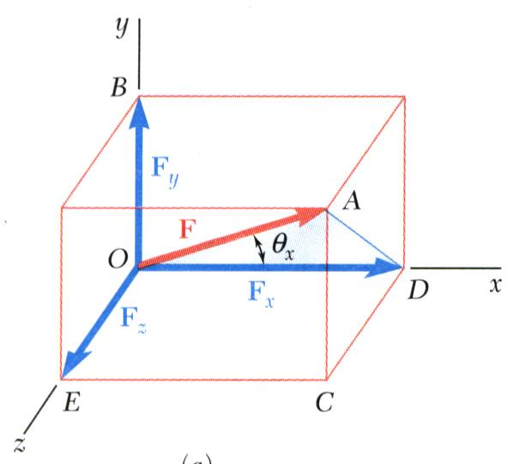
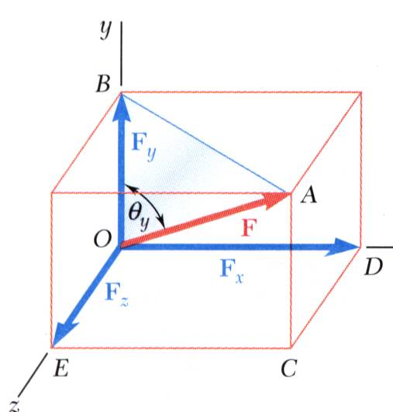
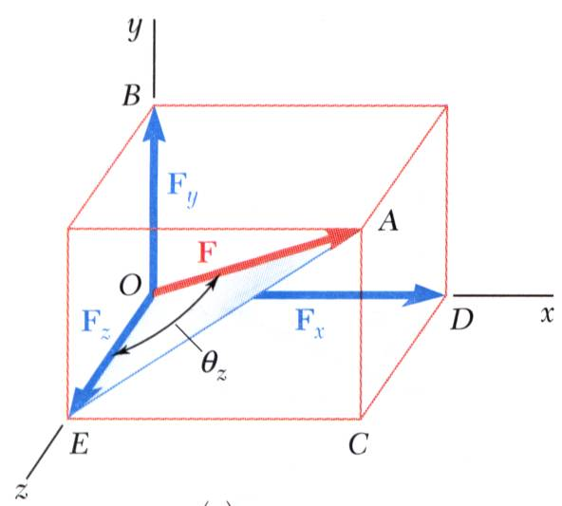
Forces in 3D

Slide 41
Turning Effect of a Force: Moments
F
d
The tuning effect of a force is measured by the moment Fd

Slide 42
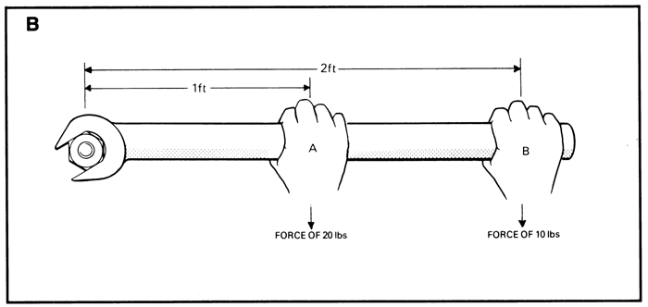
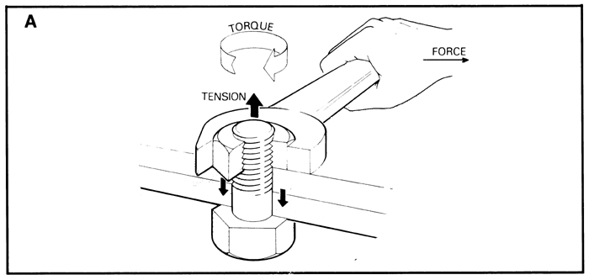
Moment/ Torque

Slide 43

Moment is a Vector
F
●
r
M = r× F
Right-Hand Rule

Slide 44
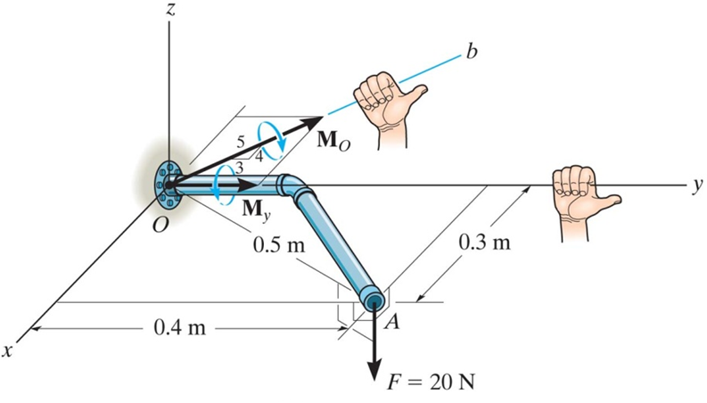
Example

Slide 45
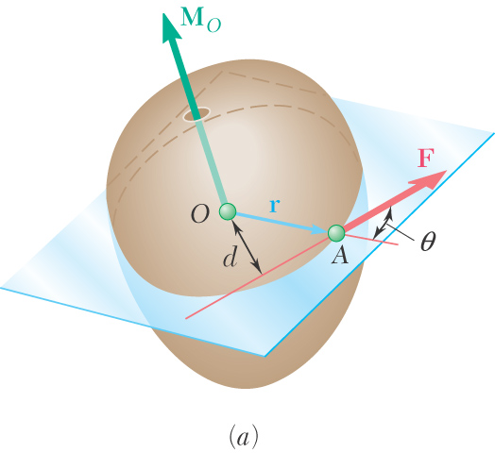
Moment of a Force about a Point
Moment Vector:
Magnitude:
Position Vector:
Perpendicular distance = d

Slide 46
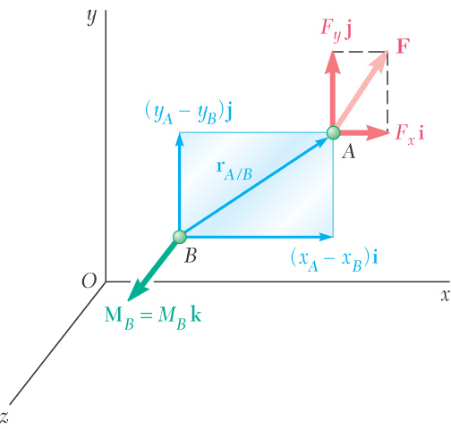
Determining Moments in 2D
Determine + or - by the
right hand rule
For the picture here:

Slide 47
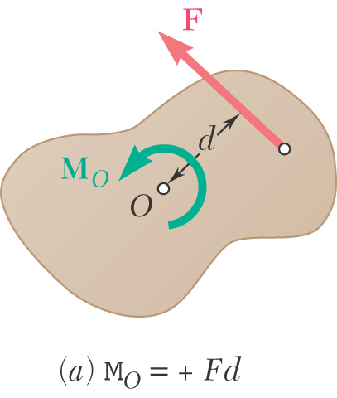
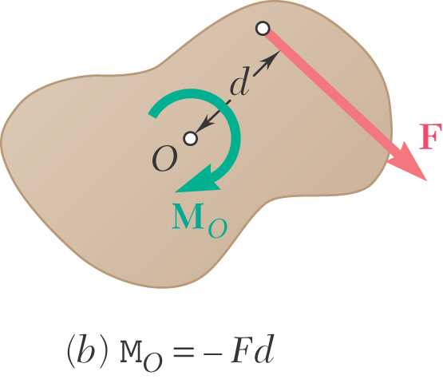
Determining Moments in 2D
Right Hand Rule:
●
×

Slide 48
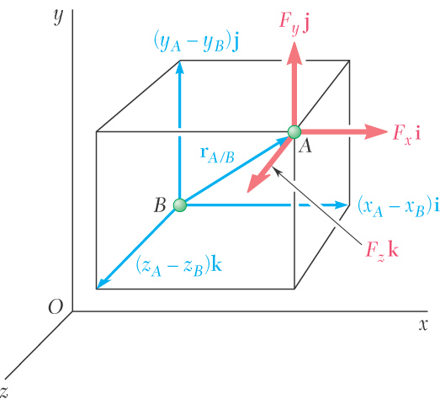
Determining Moments in 3D
Moment Vector
Position Vector:

Slide 49
Calculating a Vector Cross Product
4
5
6
1
2
3

Slide 50
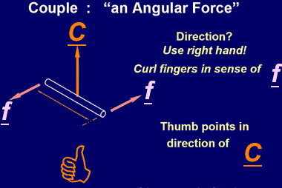
Couple: Vector
r
C = r X F

Slide 51
Moments Caused by Couples
Moment vector caused by a couple is sometimes called a “couple vector”
Has components:
Moment caused by a couple is a “free vector”; you can place it at any point

Slide 52
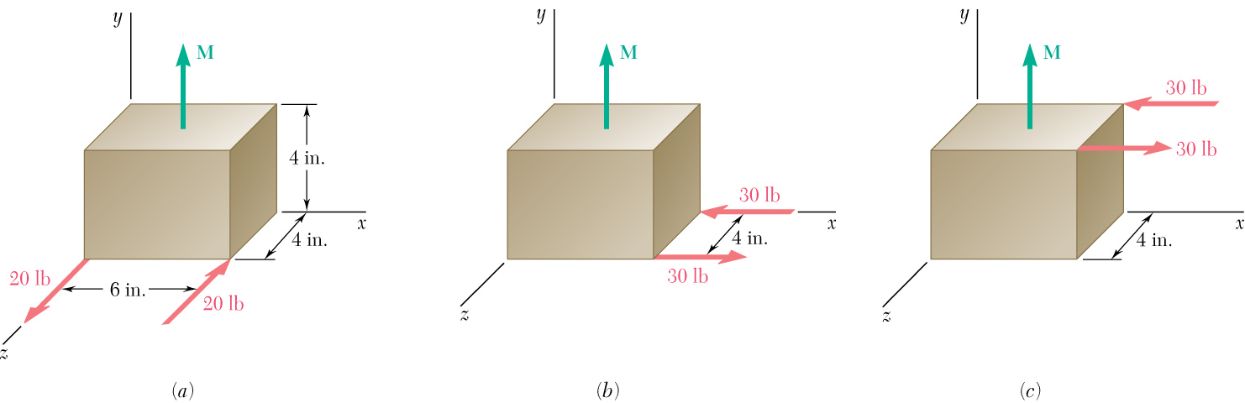
Equivalent Couples
Two couples are equivalent if they cause the same moment:

Slide 53
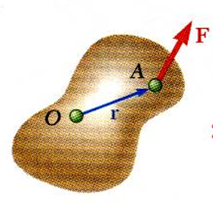
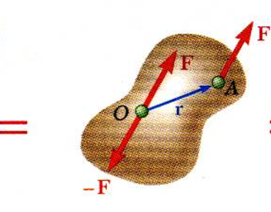
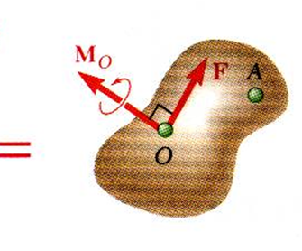
Force-Couple System
A force, F, acting at point A can be replaced by the force, F, and a moment, M_{O}, acting at point O.

Slide 54
Create a Force-Couple System at a Chosen Point
F
F
F
F
B
A
B
A
B
A
=
=
M_{A}
d
F
M_{A} = d F

Slide 55
Reducing a System of Forces to a Resultant Force-Couple System (at a Chosen Point)
F₁
R
r₁
r₂
F₂
A
=
r₃
M_{A}
F₃

Slide 56
Reduce a System of Forces to a Single Resultant Force
F₁
R
R
R
r₁
r₂
B
F₂
A
=
=
r₃
M_{A}
M_{A}
R
R
F₃
Using method
from prior slide
B
=

Slide 57
Equipollent Force System
P
P
P
L

Slide 58
Equipollent Force System
P
PL

Slide 59
Equipollent Force System
Centre of Gravity

Slide 60
Equipollent Force System
L
L
Aerodynamic
Centre
Centre of pressure
M

Slide 61
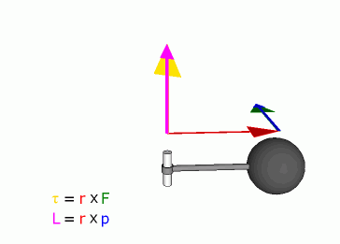
Moment/Torque
Source: Wikipedia

Slide 62
Equilibrium

Slide 63
Equilibrium
System does not accelerate
Consequence of first law
No net force.

Slide 64
Is That Enough?
It will rotate till the two forces are in line.

Slide 65
Equilibrium
For a particle: ∑F = 0
For a rigid body: ∑F = 0, ∑M = 0

Slide 66
Equilibrium
∑F = 0
∑ F_{x} = 0; ∑ F_{y} = 0; ∑ F_{z} = 0
∑M = 0
∑ M_{x} = 0; ∑ M_{y} = 0; ∑ M_{z} = 0

Slide 67
Free-Body Diagrams

Slide 68
Free-Body Diagrams (FBD)
A free-body diagram of a structure or a part of the structure removed from its support.
It shows all the (external) forces acting on that part of the structure.
The supports are replaced by the forces that the supports apply on the structure.

Slide 69
Free-Body Diagram (FBD)

Slide 70
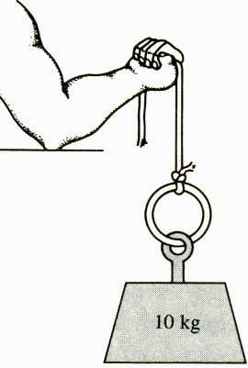
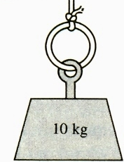
Free-Body Diagrams (FBD)...
Tension in the rope ??
T
T = W
W

Slide 71
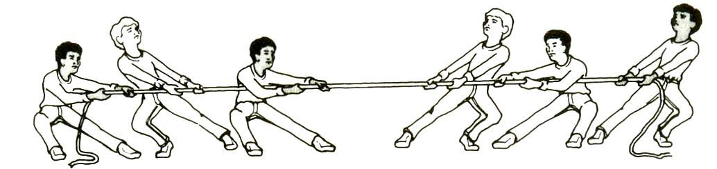
Free-Body Diagrams (FBD)...
250 N
250 N
300 N
? N
250 N
300 N
∑F = 0
? = 250 N

Slide 72
Free-Body Diagrams (FBD)...
Tension ?
T
250 N
250 N
300 N
T = 800 N

Slide 73
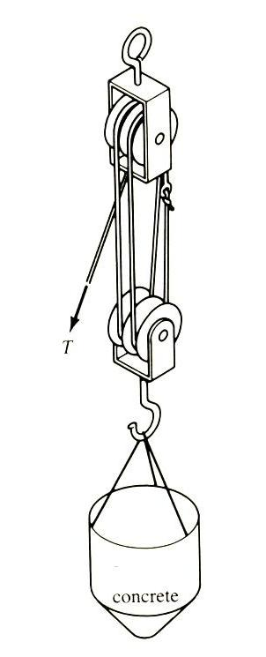
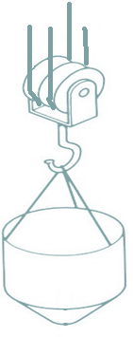
Lifting Pulley Block
T
T
T
T
T = W/4
Mechanical Advantage
W

Slide 74
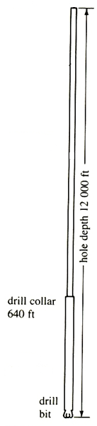
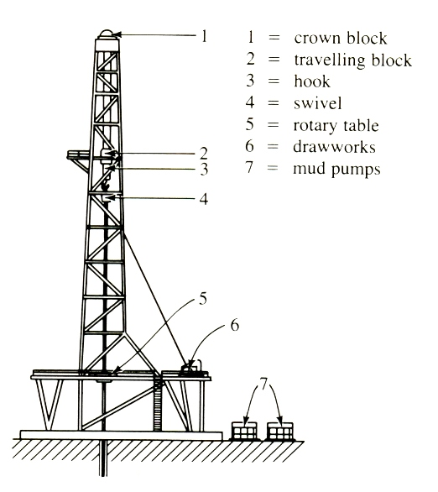
Oil-Well Drill
T
W₁
Staging?
W₂
Bit force

Slide 75
Equilibrium: System of Particles
F₂
F₂₁ = − F₁₂
F₃₁ = − F₁₃
F₂₃ = − F₃₂
F₁, F₂, F₃ must be in ≡m
2
F₂₁
F₂₃
F₃₁
F₁₂
3
F₁₃
F₃₁
1
F₁
F₃

Slide 76
Equilibrium: System of Particles..
F₂
F₁, F₁₂, F₁₃ must be in ≡m.
2
F₂₁
F₂₃
F₃₁
F₁₂
3
F₁₃
F₃₁
1
F₁
F₃

Slide 77
A Two-Force Member
Any object with two forces acting on it will be in equilibrium only if the two force are equal, opposite and act in line.

Slide 78
A Two-Force Member
Any object with two forces acting on it will be in equilibrium only if the two force are equal, opposite and act in line.

Slide 79


Two-Force Members

Slide 80
Two-Force Members...
F
F
F
F
F
F

Slide 81
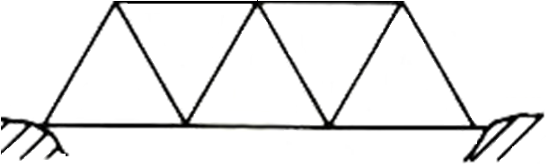
A Two-Force Member...

Slide 82
A Three-Force Member
Co-planar
Concurrent

Slide 83
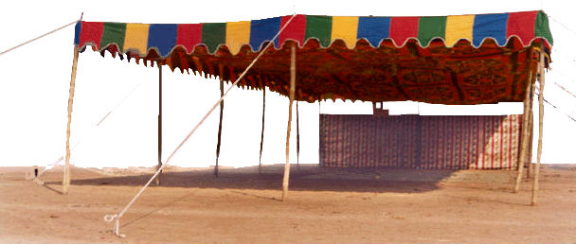
Restraints or Supports
Simply supported:
No moment. Only reaction force.
Cannot translate,
Can rotate.

Slide 84
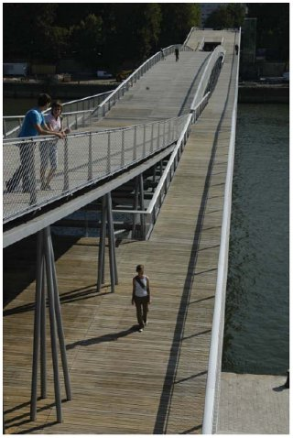
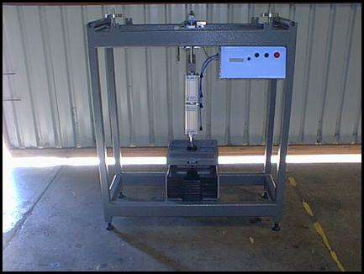
Simply Supported

Slide 85


Simply Supported...
Roller Support: Normal reaction only. (2DoF)
Pinned Support: Reaction could be inclined. (1DoF)

Slide 86


Step Ladder
FRICTION

Slide 87



Leaning Ladder
R_{H2}
R_{H1}X4 – 600X0.5 = 0
or R_{H1} = 75 N
Or,
N
4 m
R_{V1}
y
600 N
R_{H1}
x
1 m
z

Slide 88
Additional Reference
http://web.mst.edu/~mecmovie/index.html

Slide 89

Truss
3m
θ
cosθ = 4/5,
sinθ = 3/5

Slide 90

Method of Joints
Symmetry:
2F_{GC} sinθ – 15 kN = 0
F_{GB}
F_{GC}
F_{GC} = (15 X 5)/(2 X 3)
= 12.5 kN
F_{GF}
F_{GA}
15 kN

Slide 91
Method of Joints
F_{CB}
-F_{CG}sinθ - F_{CF}sin θ = 0
F_{CF} = - F_{CG} = -12.5 kN
F_{CG}
F_{CF}
F_{CB} – F_{CG}cosθ + F_{CF}cosθ = 0
F_{CB} = –2F_{CG}cosθ = 10 kN

Slide 92
Method of Joints
R_{B,V}
F_{FC}
F_{FG}
∑F_{V} = R_{B,V} +(3/5)F_{FC} = 0
or, R_{B,V} = - (3/5)F_{FC} = + 7.5 kN
∑F_{H} = -(4/5)F_{FC} - F_{FG} = 0
or, F_{FG} = - (4 /5)F_{FC} = 10 kN

Slide 93


Clamped Support
While in the pinned support, the member is restrained from translating, in the clamped support, the member cannot even rotate.

Slide 94

Clamped Support...
x
x
x
Cannot translate,
Cannot rotate.
No DoF at all.
Also called built-in support

Slide 95



Clamped Support...
P
F_{y}
F_{x}
M_{z}
L
y
Statically determinate
x
z

Slide 96

An Example: Pinned Truss
B
D
C
20 kN

Slide 97
An Example: Pinned Truss...
F_{D,DB}
B
B
D
F_{D,DC}
F_{BD,D}
20 kN
D
D
C
BD is a 2-force member.
So is CD
20 kN

Slide 98




An Example: Pinned Truss...
∑F_{y} = 0
F₂
∑F_{x} = 0
= 20 kN
D
F₁
20 kN

Slide 99

Another Truss
150
70.7 T
150
0

Slide 100
Another Truss
- 200 C
- 213 C
70.7 T

Slide 101
Another Truss
- 213 C
150 T

Slide 102

Another Truss

Slide 103

Another Example of Two-Force Members

Slide 104


Two-Bar Assembly
60º
30º
F₁cos30º – F₂cos60º = 0
F₁sin30º + F₂sin60º – 500 = 0
500 N
F₁ = 125 N; F₂ = 433 N

Slide 105




Segmented Axial Bar

